Slide 1


Institute of Technology of Cambodia
Department of Mechanical and Industry
Subject: Turbomachines (Centrifugal Pump)
Lecture : Mr. DARA SEYHAK
Group: I4-GIM-A1-Gr1
Student’s Name ID
BAN THUNPISEY e20220860
BUNTHEN CHANSOYUTHARITH e20220219
CHAO SIVCHHUONG e20220409
CHAT CHANPARADY e20221655

Slide 2
Contents
Introduction 3
Objective 4
Scope of work 5
Methodology 6
1. Theory and Formula 7
2. Simulation 8
2.1. CAE 9
2.2. CAD 12
2.3. CFD 13
Technical 15
Result 16
Conclusion 17
References 18

Slide 3
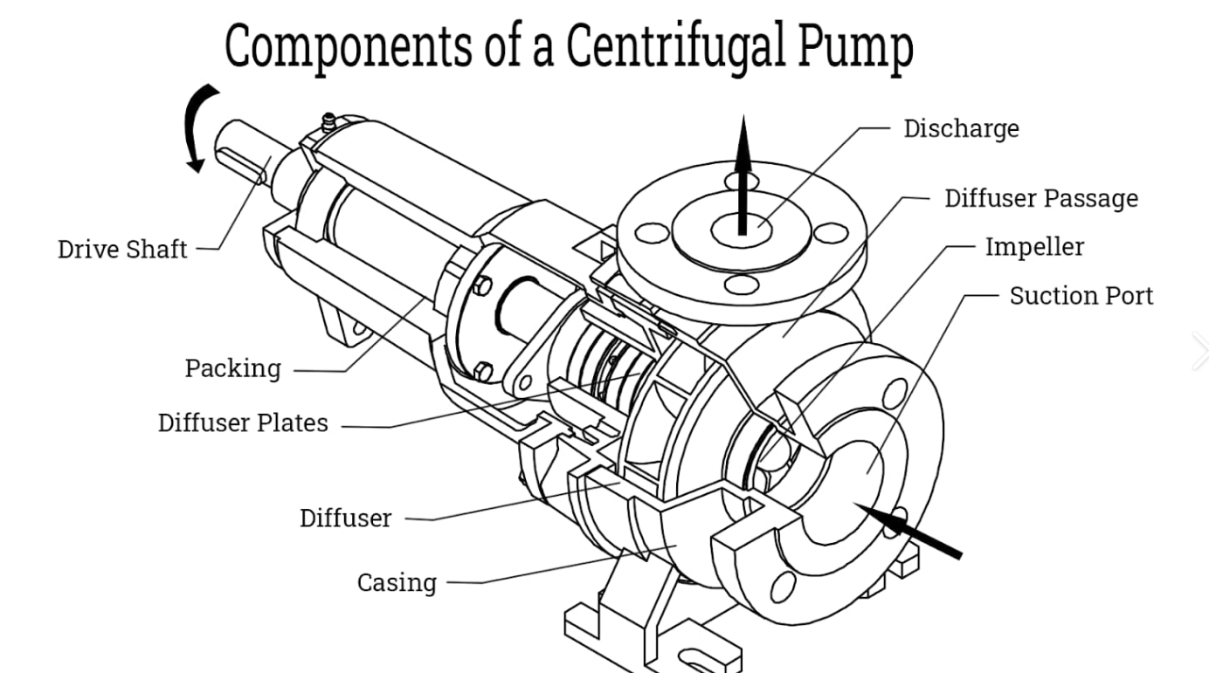
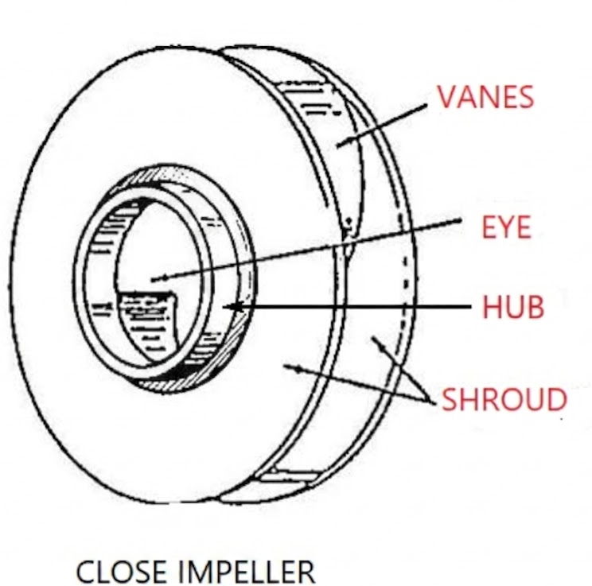
I. Introduction
The centrifugal pump, which was used to move liquids. In a centrifugal pump, fluid entered the center of a rotating impeller and was pushed outward by rotation. This increased the fluid’s speed and pressure. The volute casing then converted this speed into pressure energy.

Slide 4




II. Objective
Evaluate Pump Performance : Compare theoretical predictions with experimental results.
Diagnose System Issues: Identify testing discrepancies and improve system reliability.
Analyze Performance Characteristics : Plot and interpret pump and flow characteristic curves.
Optimize Efficiency : Determine the most efficient operating conditions.

Slide 5
III. Scope of work
Scope of work
Team Responsibilities
Start
BAN THUNPISEY
BUNTHEN CHANSOYUTHARITH
Problem
Geometry parts
Report checking
Target the objectives
Objective
Technical
Conclusion
Collect data
CAE
(MATLAB )
CHAO SIVCHHUONG
CHAT CHAN PARADY
CAD
(SOLIDWORKS)
Lead team
Analyse
Calculation
Theory
Formula
Strategy and flow chart
CFD
(ANSYS)
Result
Comparing
End

Slide 6

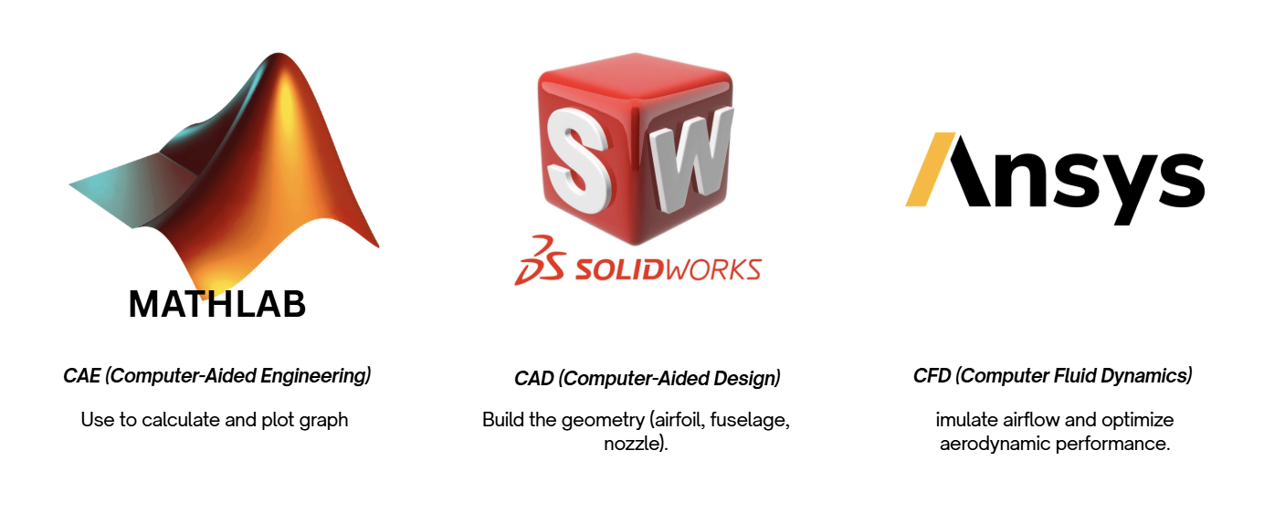
IV. Methodology
Methodology
Theory and Formula
Simulation
CAE
CAD
CFD

Slide 7
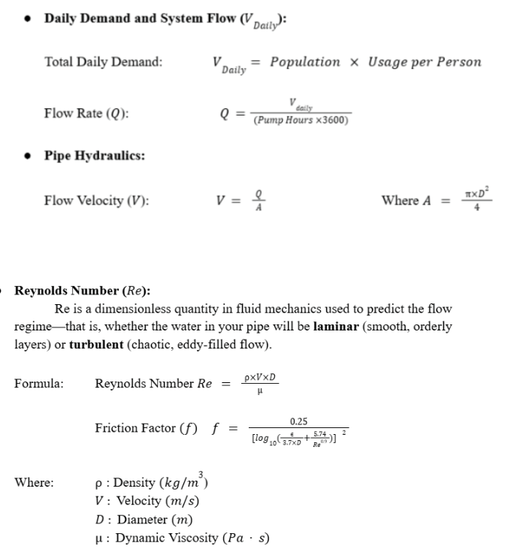
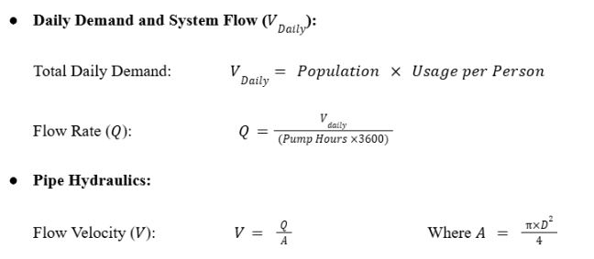
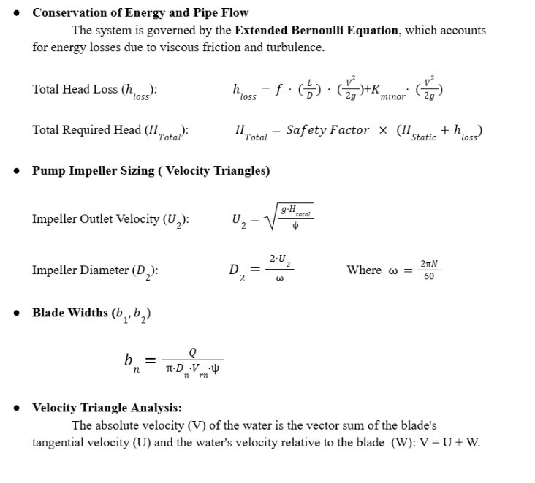
1. Theory and Formula

Slide 8
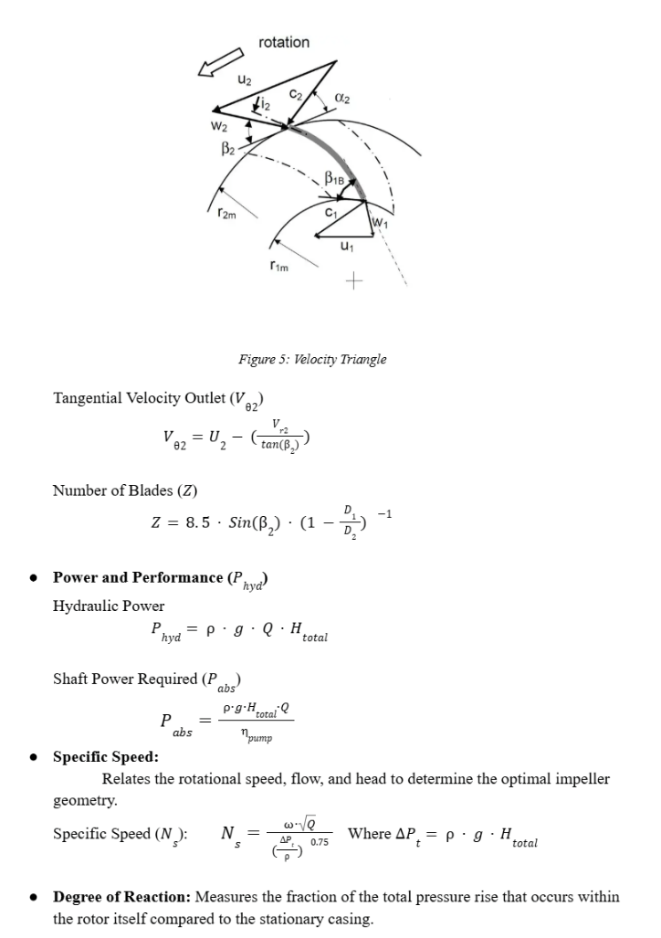
1. Theory and Formula

Slide 9
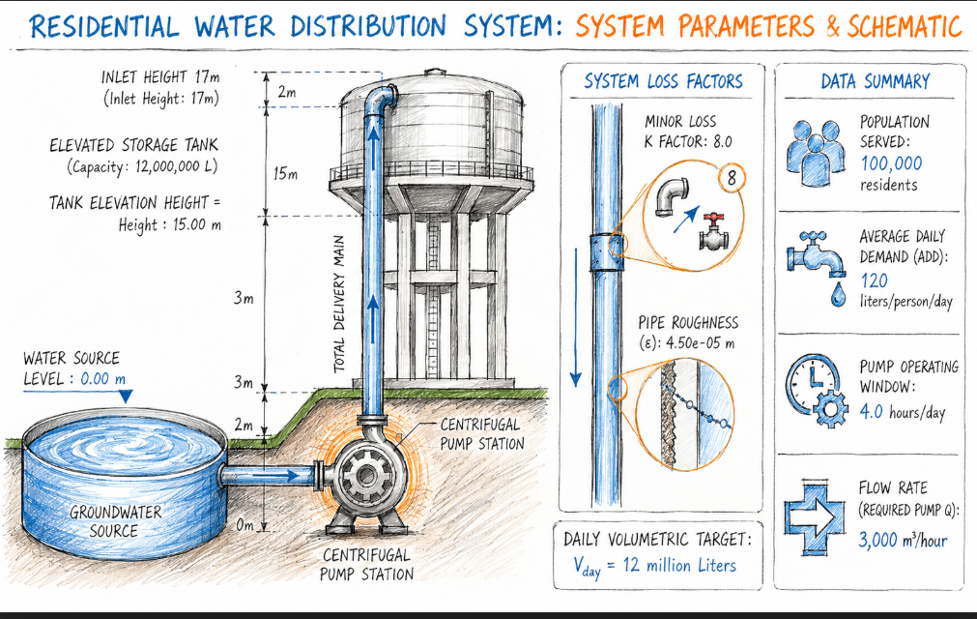
2. Simulation
Population & System Inputs
People : 100000 residents
Use Per Person : 120 liters/person/day
Tank Elevation Height : 15.00 m
Water Source Level : 0.00 m
Pump Operating Hours: 4.0 hours/day
Minor Loss K Factor : 8.0
Pipe Roughness (epsilon): 4.50e-05 m
Efficiencies
Hydraulic Efficiency : 0.874
Volumetric Efficiency : 0.970
Mechanical Efficiency : 0.948
Pump Overall Efficiency : 0.804

Slide 10
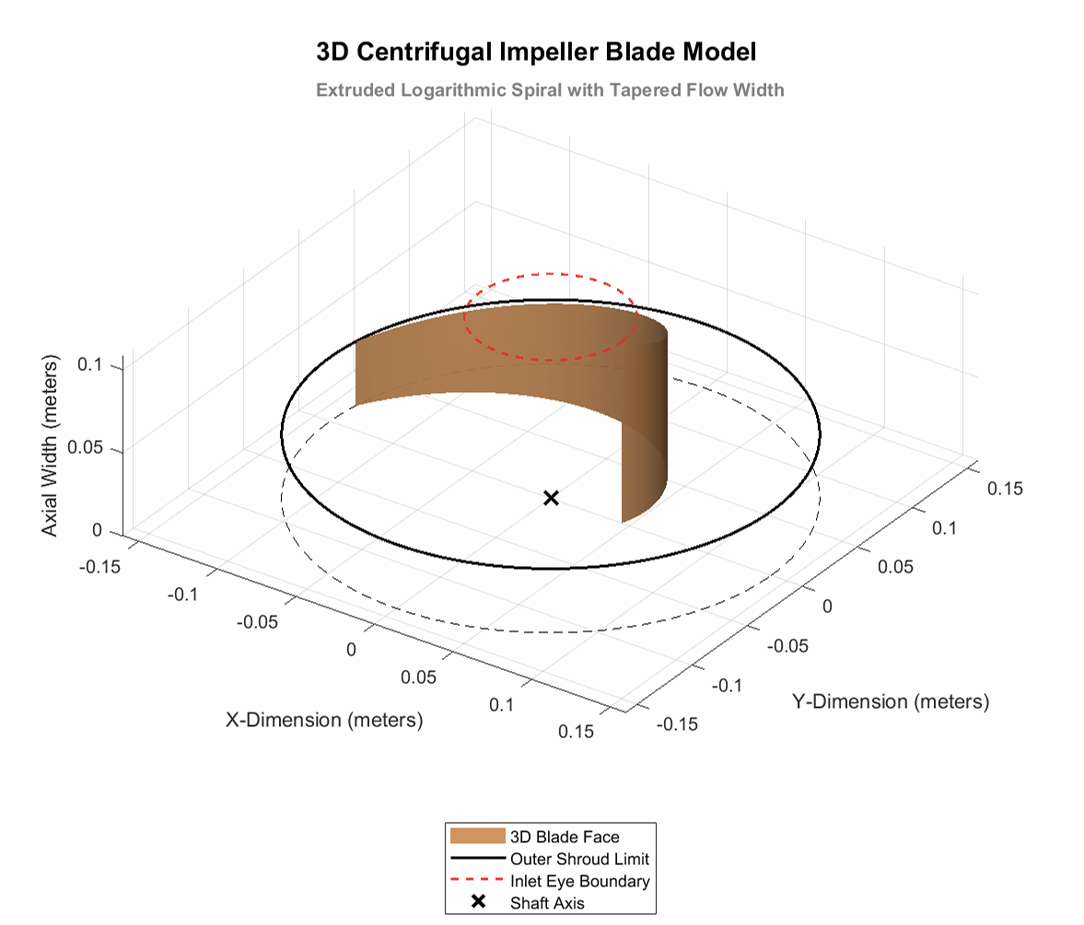
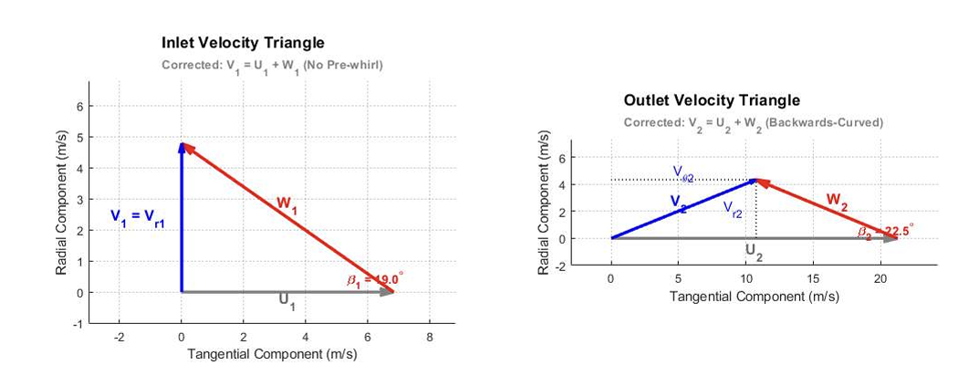
2.1. CAE
The water at the exact moment it enters the pump
The water as it exits the pump. Because the impeller is spinning, the blade tip is moving much faster, adding significant energy to the water
This diagram shows the actual 3D volume of a single impeller blade. The brown surface represents the "blade face," which is the part that physically pushes the water as it rotates around the center shaft (the 'X').

Slide 11
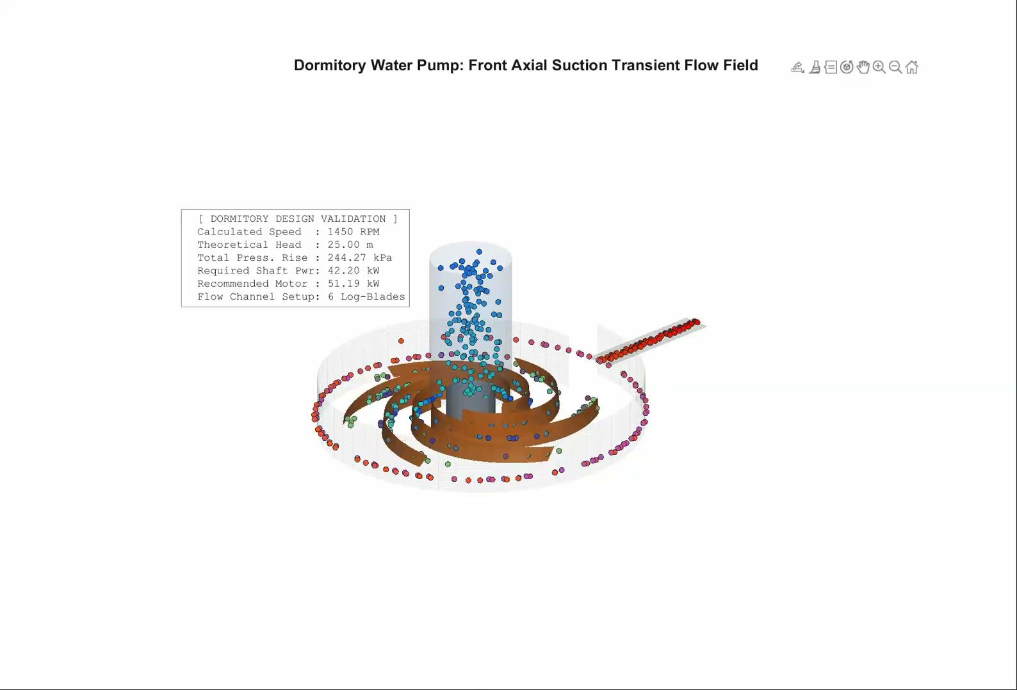
2.1. CAE

Slide 12
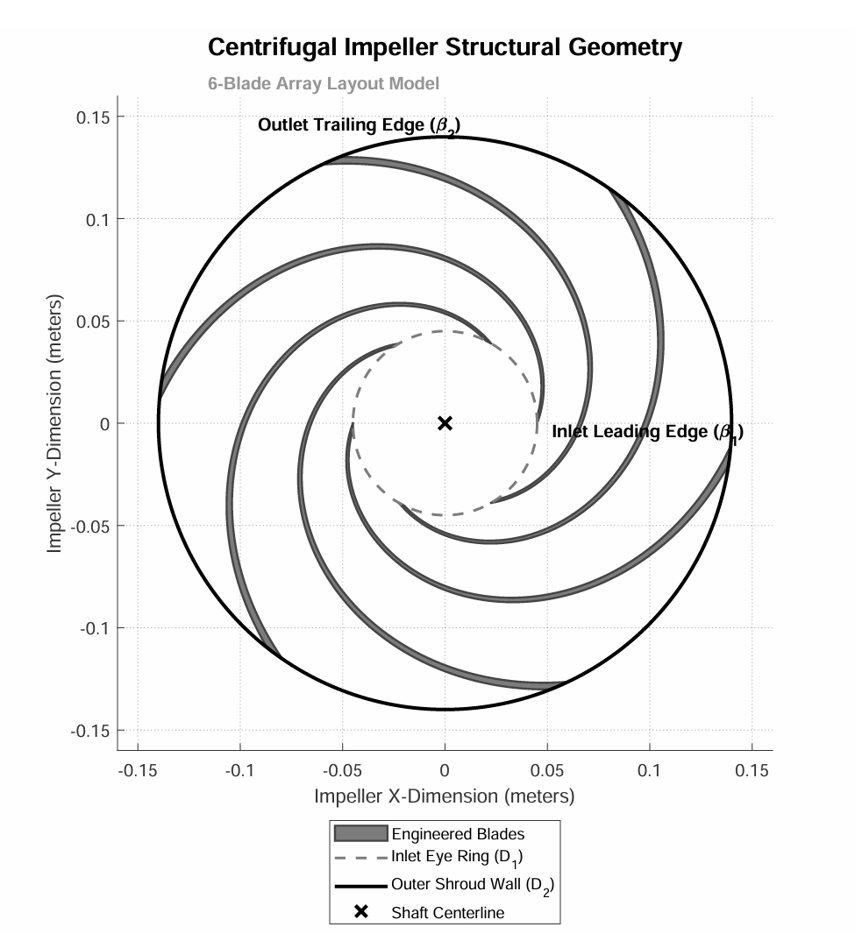
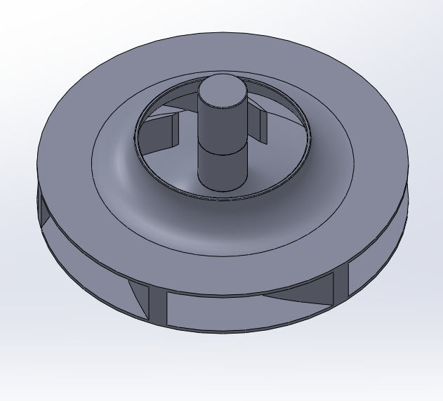
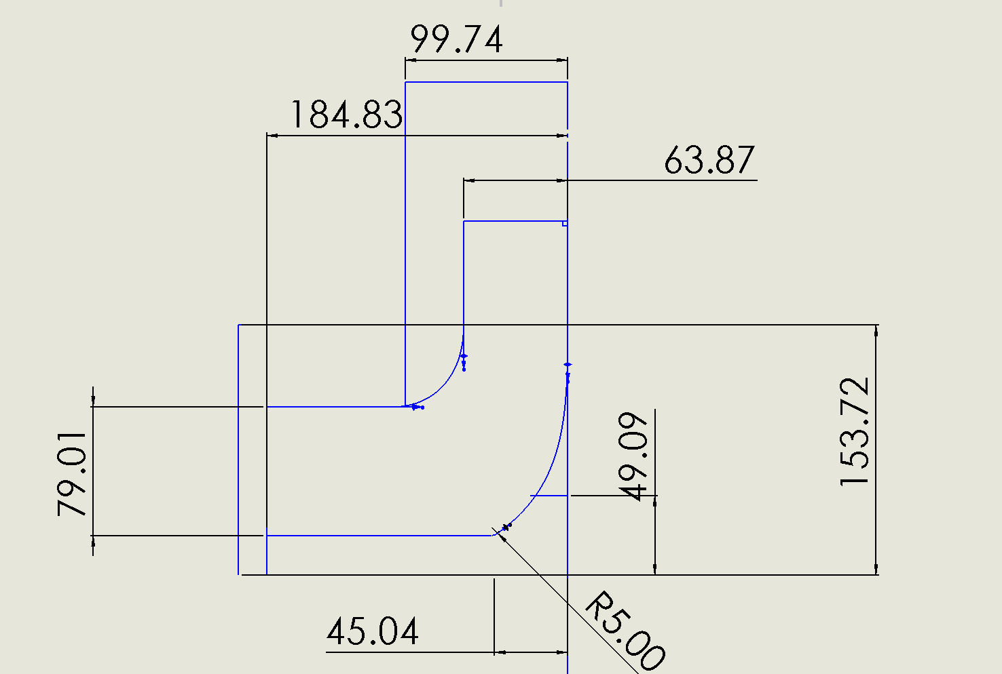
2.2. CAD
Blade Angle
3D Model
2D Model
The 3D model of the enclosed centrifugal impeller was constructed by first executing a Revolve feature of the meridional cross-section sketch to establish the solid hub and shroud volumes.
shows how the six blades are arranged around the center shaft. The blades act like scoops, catching water at the inner inlet and pushing it outward to the outer edge.

Slide 13
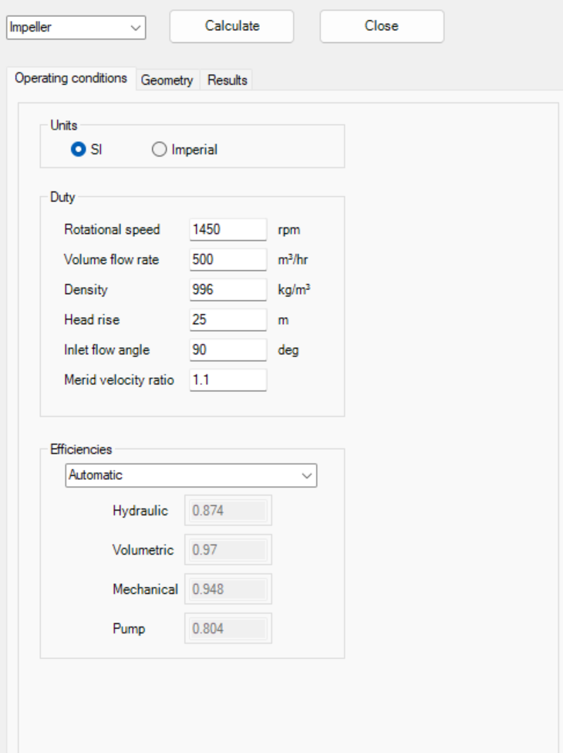
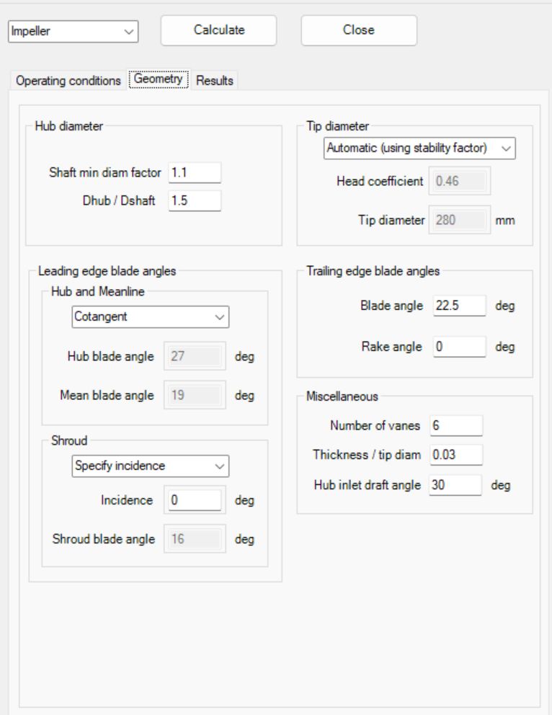
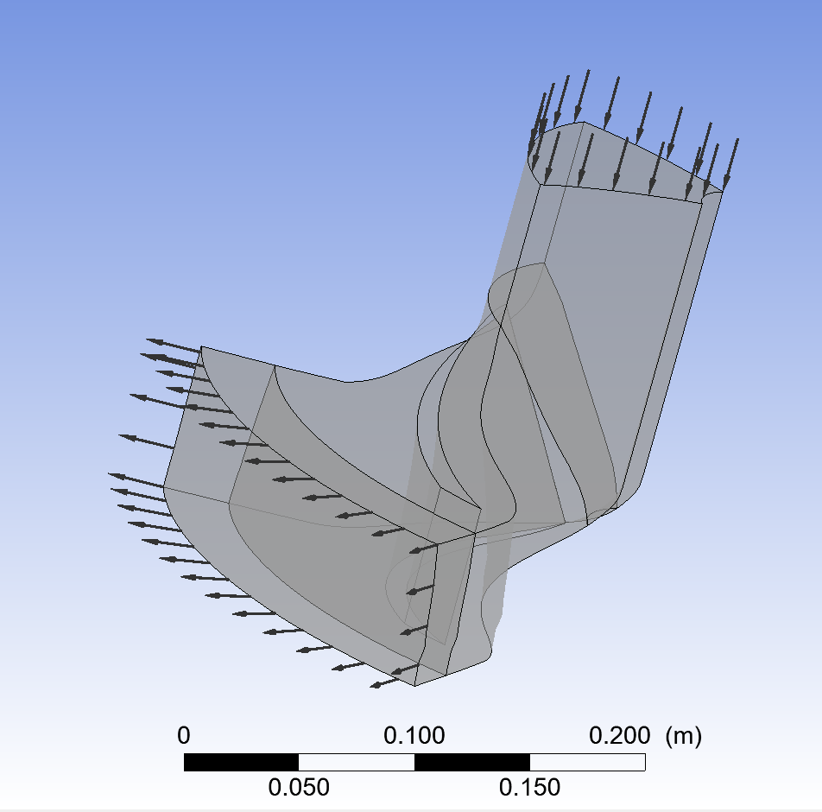
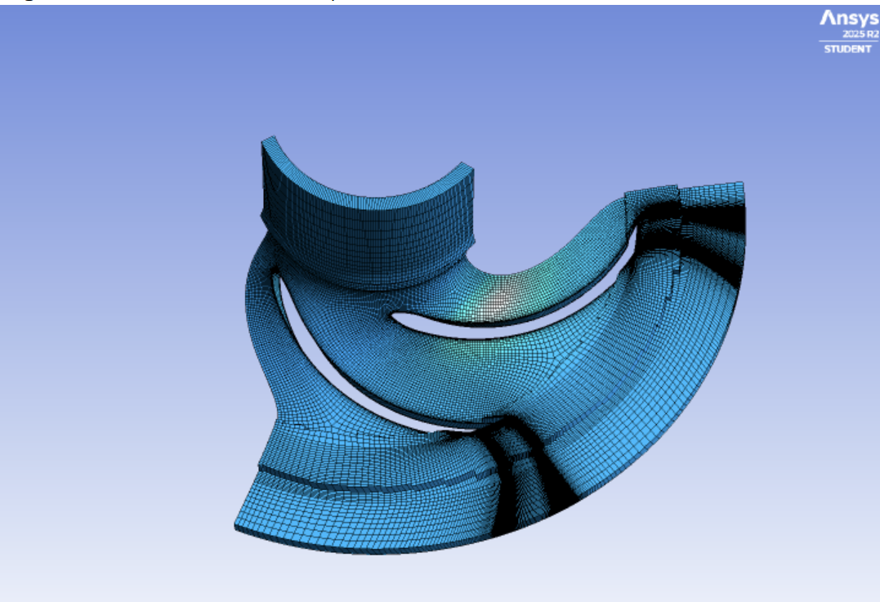
2.3. CFD
Input Parameter
Conditions
Mesh Size
Use this diagram to show:
- How the fluid enters axially through the suction eye
- Flung outward radially into the expanding volute channel.
Mesh:
- Mesh independence validation matrix tracking peak structural stress/pressure head.
Use this to explicitly justify your calculations:
- For channel widths b_1, b_2 and the specific backward-shrouded design that maintains high hydraulic efficiency.

Slide 14
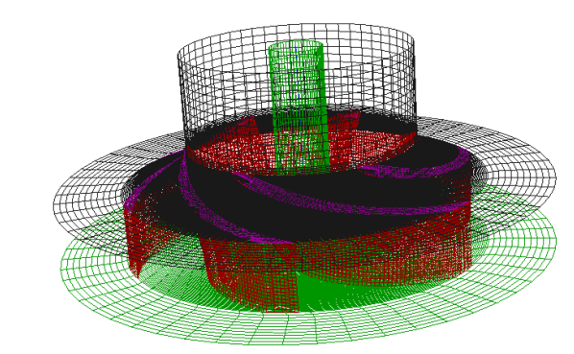
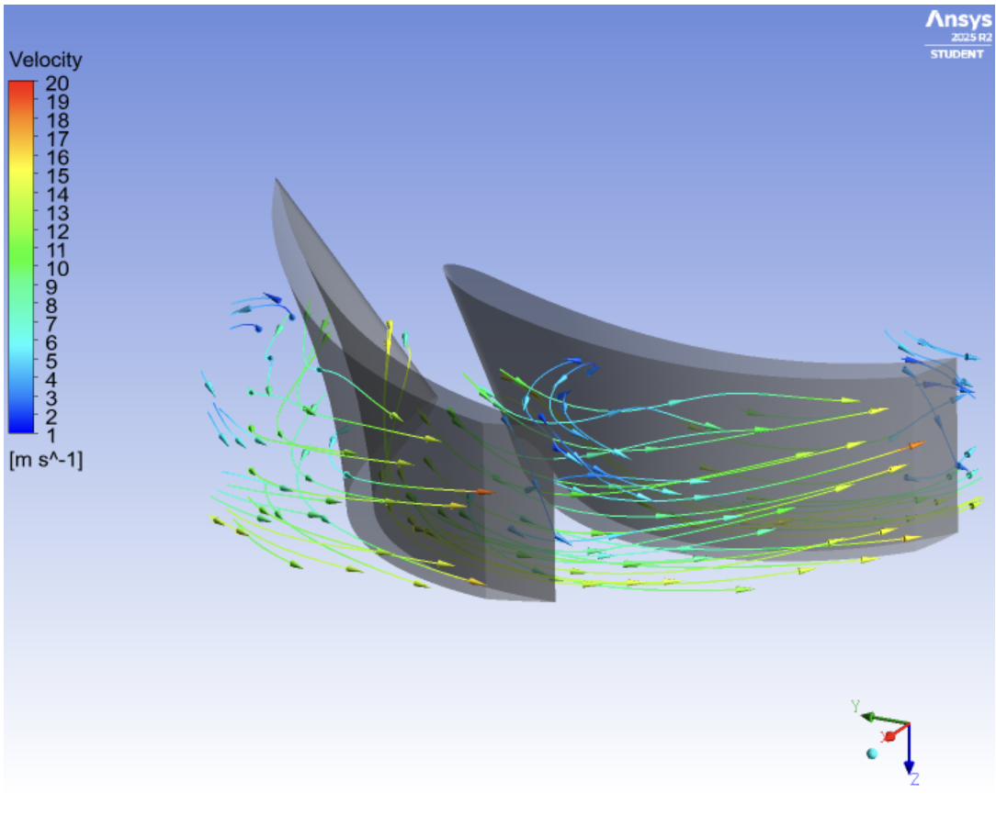
2.3. CFD
ANSYS CFD analysis confirmed the impeller efficiency by meshing the fluid domain to solve for pressure and velocity. The results show stable flow and minimal turbulence, validating that the blade geometry optimizes energy transfer and hydraulic performance.
The plot confirms that the impeller design is highly efficient. The smooth, color-coded streamlines demonstrate stable fluid acceleration from inlet to outlet, which minimizes turbulence and ensures optimal energy transfer for better pump performance.

Slide 15
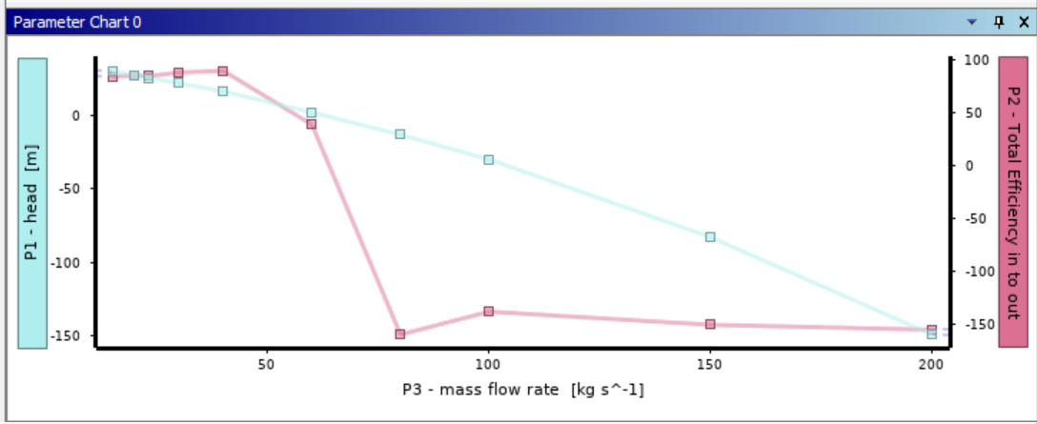
V. Result
Optimal Performance: The efficiency follows a parabolic trend, climbing from 84.01% to a Best Efficiency Point (BEP) of 89.45% at 40.00 kg/s, where the blade geometry and fluid flow are perfectly aligned.
Performance Collapse: Beyond the BEP, efficiency drops sharply to 38.60% at 60.00 kg/s, as internal hydraulic losses and high fluid velocities exceed the impeller's capacity to handle the flow.

Slide 16
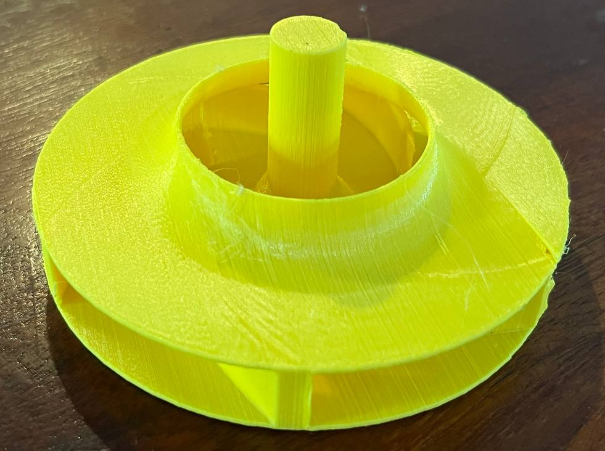
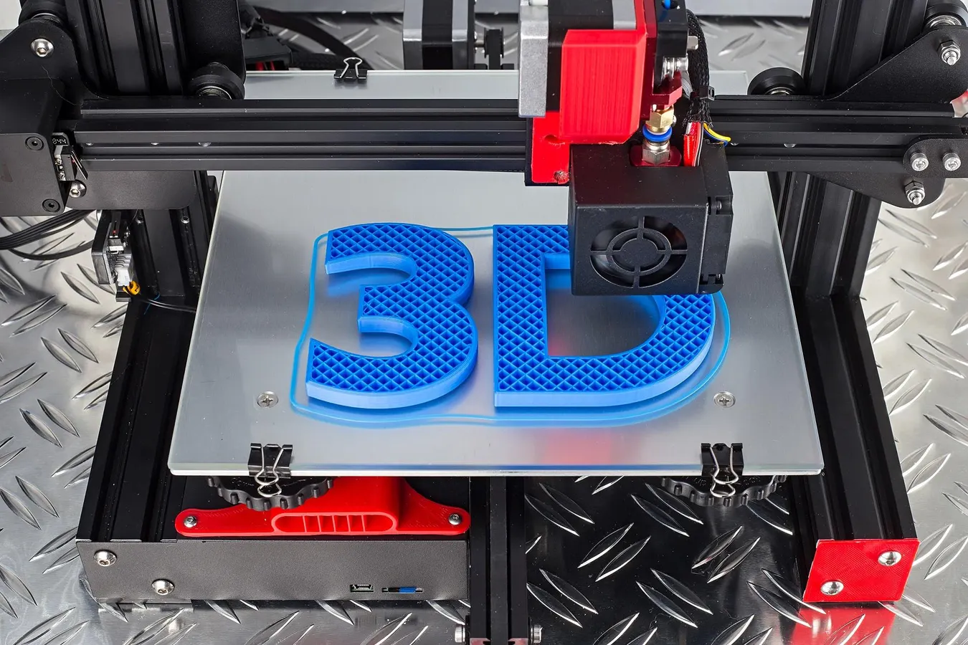

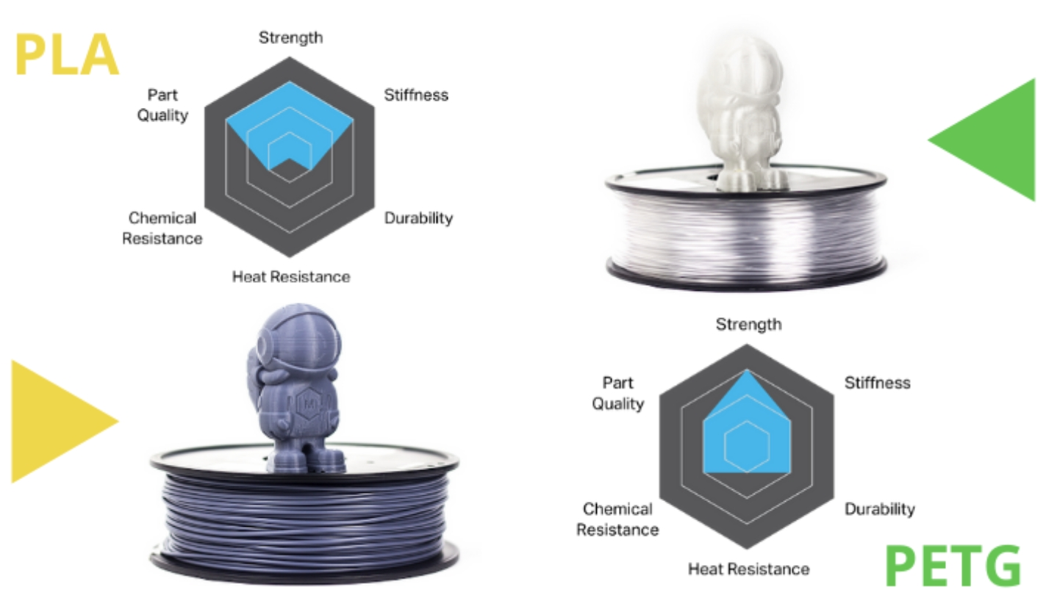
VI. Technical
Concept Design
Prototype
3D printing
Manual Fabrication
Material (PLA Vs PETG)
Potential Causes of Failure in 3D-Printed Impellers:
Thermal Instability
Mechanical Fatigue
Dynamic Imbalance
Geometric Inaccuracy
Structural
Overloading

Slide 17
VII. Conclusion
The performance analysis shows that the impeller design is highly effective within its target range:
Stable Operation & BEP: The system exhibits a stable, declining head curve between 15.00 kg/s and 40.00 kg/s. The Best Efficiency Point (BEP) is achieved at 40.00 kg/s, where the impeller reaches a peak hydraulic efficiency of 89.45%, indicating excellent geometric alignment between the blade curvature and fluid stream paths.
Performance Breakdown: Beyond 40.00 kg/s, the system reaches its geometric choke limit. As mass flow increases toward 60.00 kg/s, both the head and efficiency collapse sharply with efficiency dropping to 38.60%, due to severe turbulence, boundary layer separation, and internal friction losses that exceed the impeller structural handling capacity.

Slide 18
VIII. Reference
1. TCAE-CFDSUPPORT-Centrifugal-Fan-Design-and-Simulation.pdf-.pdf
2. Centrifugal Fan Design And Simulation – CFD SUPPORT
3.https://github.com/chhuong432-tech/My-References/blob/main/Centrifugal%20Pump.df
4. https://github.com/chhuong432-tech/My-References/blob/main/PumpReport.htm

